Slide 1
Mileage Multiplier

Slide 2


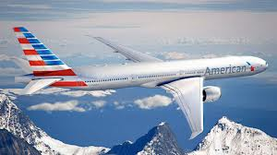



Aadvantage
Don’t have enough AAdvantage miles to....
Go on a vacation?
Book a flight?
Rent a car?
Or stay in a hotel?
What you need is a Mileage Multiplier!!!! !!

Slide 3
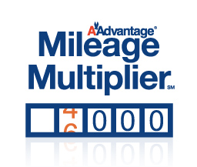
Overview
Mileage Multiplier allows AAdvantage members to multiply the number of AAdvantage miles they earn
Can double or triple the number of miles earned during their flight
The cost is approximately 3 cents per mile

Slide 4
Where ? When ? Who ? How ?
Where to purchase:
On AA.com or at a Self-Service Check-In machine
When to purchase:
When checking-in for your flight
For travel within:
All eligible flights worldwide
For whom:
AAdvantage members
How does it work ?
Make your reservation – be sure to include your AAdvantage number
Check in for your flight at AA.com or visit any Self-Service Check-In machine throughout the U.S., Puerto Rico and the U.S. Virgin Islands
Simply swipe your credit card to purchase up to three times the number of miles flown on your trip

Slide 5
More about Mileage Multiplier
If I didn't purchase Mileage Multiplier miles at the time of check-in, can I still participate in this offer?
Yes. Prior to the departure of your flight, go to the SSM at the airport and select either the Reprint Boarding Pass or the Check Baggage Option. And you will be presented with the Mileage Multiplier offer.
Why wasn't I offered the Mileage Multiplier option for my trip?
There are several circumstances under which Mileage Multiplier may not be available,
Your AAdvantage number was not included in your reservation
Your reservation includes travel on airlines other than American Airlines, American Eagle or the American Connection carrier or is on a codeshare flight.
You are checking in for your flight at a Self-Service Machine outside of the U.S., Canada, Puerto Rico, or the U.S. Virgin Islands
Our systems are undergoing maintenance or are unavailable.

Slide 6
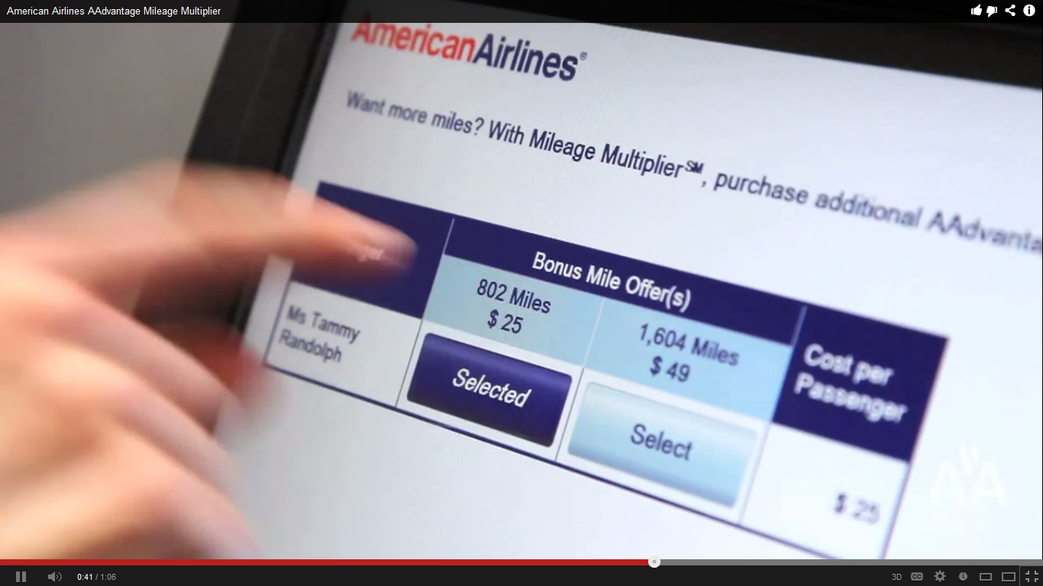
Bonus Miles : Purchase and Refund
What happens if my flight cancels or is re-routed? Will I still receive the bonus miles purchased?
You will still receive the bonus miles purchased, regardless of whether or not your flight is cancelled or re-routed.
Are the bonus miles purchased through the Mileage Multiplier offer refundable?
No. Bonus miles purchased through the Mileage Multiplier offer are non-refundable.

Slide 7
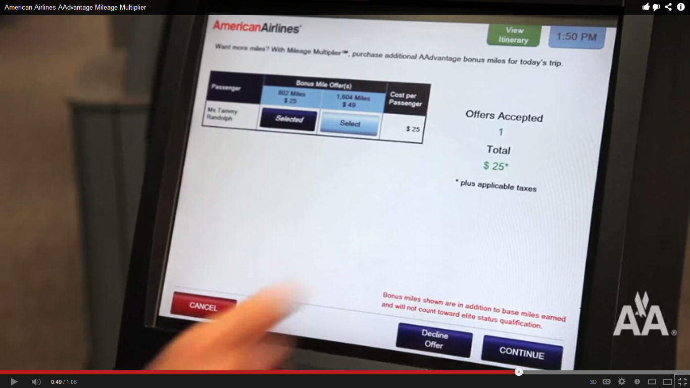
Bonus Miles : Limit on purchase
Is there an annual maximum on the number of bonus miles that can be purchased through the Mileage Multiplier offer?
No, there is no limit to the number of bonus miles you can purchase through the Mileage Multiplier offer.

Slide 8
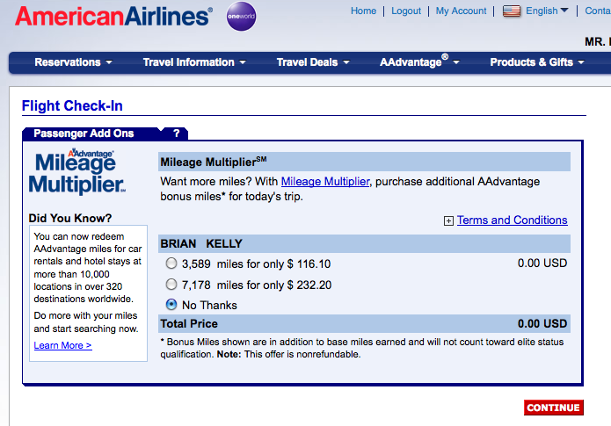
Elite Status with Bonus miles ?
Do the purchased bonus miles count toward elite status qualification?
No, bonus miles do not count toward qualification for elite status membership or Million MilerSM status, but they will add to your total available award mileage balance.
How soon will my bonus miles post to my account?
Bonus miles will post to your account within 48 hours of the time of purchase. Mileage Multiplier miles may even post to your account before you arrive at your destination.

Slide 9

Purchase Additional AAdvantage Bonus miles
Are there other ways to purchase additional AAdvantage bonus miles?
You may purchase additional AAdvantage bonus miles through the buyAAmiles® program or giftAAmiles(SM) program
You can share existing miles through the shareAAmiles(SM) program
Visit www.aa.com/buymiles for details

Slide 10
Example
Mileage Multiplier Bonus Offer
One-Way Trip Between: | Base Miles | Double Miles |  | Triple Miles
 |  | Bonus Miles | Cost | Bonus Miles | Cost
Miami – Turks & Caicos | 578 | 578 | $18 | 1,156 | $35
Chicago O'Hare – DFW | 802 | 802 | $25 | 1,604 | $49
DFW – Miami | 1,121 | 1,121 | $34 | 2,242 | $68
Los Angeles – New York/JFK | 2,475 | 2,475 | $75 | 4,950 | $149
New York/JFK – Madrid | 3,589 | 3,589 | $108 | 7,178 | $216

Slide 11
Rewind & review
Can only be purchased at Self-Service or AA.com during check-in
Bonus miles do not count toward qualification for elite status membership If your flight is cancelled you will still receive the bonus miles purchased
Bonus miles purchased through the Mileage Multiplier offer are non-refundable
There is no limit to the number of bonus miles you can purchase through Mileage Multiplier
You can choose to purchase bonus miles for one, some or all AAdvantage members in the reservation
If the base miles associated with your flight(s) are less than 300 miles, you will be offered the option to purchase a minimum of 300 Mileage Multiplier miles
Your miles will never expired as long as there is some activity in your account every 18 months

Slide 12



Use Mileage Multiplier : Travel less & Earn more

Slide 13
Divider slide in approved brand
colors (see layout options)

Slide 14
Half Image Slide with Image or Chart on Left
Body copy in AA Dark Gray, Arial 20pt with single line spacing
  Bullet one using indent button in AA Dark Gray, Arial 16pt
    Bullet two using indent button in AA Dark Gray, Arial 16pt
      Bullet three using indent button in AA Dark Gray, Arial 14pt
        Bullet four using indent button in AA Dark Gray, Arial 14pt

Slide 15
Two-thirds Image Slide with Image or Chart on Left

Slide 16
  “Quote slide in approved brand
  colors (see layout options) with text in white, Arial 40pt with single line spacing. Remove the hanging quotation marks by clicking the Decrease List Level button”

Slide 17
Bonus miles , Purchase , refund ?
What happens if my flight cancels or is re-routed? Will I still receive the bonus miles purchased?
You will still receive the bonus miles purchased, regardless of whether or not your flight is cancelled or re-routed.
Are the bonus miles purchased through the Mileage Multiplier offer refundable?
No. Bonus miles purchased through the Mileage Multiplier offer are non-refundable.
Is there an annual maximum on the number of bonus miles that can be purchased through the Mileage Multiplier offer?
No, there is no limit to the number of bonus miles you can purchase through the Mileage Multiplier offer.

Slide 18
Sample Pie Chart with Text Slide
Body copy in AA Dark Gray, Arial 20pt with single line spacing
  Bullet one using indent button in AA Dark Gray,
  Arial 16pt
    Bullet two using indent button in AA Dark Gray, Arial 16pt
      Bullet three using indent button in AA Dark Gray,
      Arial 14pt
        Bullet four using indent button in AA Dark Gray, Arial 14pt

Slide 19
Sample Bar Chart with Text Slide
Body copy in AA Dark Gray, Arial 20pt with single line spacing
  Bullet one using indent button in AA Dark Gray,
  Arial 16pt
    Bullet two using indent button in AA Dark Gray, Arial 16pt
      Bullet three using indent button in AA Dark Gray,
      Arial 14pt
        Bullet four using indent button in AA Dark Gray, Arial 14pt

Slide 20
One-third Image Slide with Image or Chart on Left
Are there other ways to purchase additional AAdvantage bonus miles?
You may purchase additional AAdvantage bonus miles through the buyAAmiles® program, giftAAmiles(SM) program or you can share existing miles through the shareAAmiles(SM) program. Visit www.aa.com/buymiles

